Slide 1
Microsoft Movie Recommendations
How to Break into the Film Industry
by Daniel Arthur, Adam Larsen, Matthew Reinhart and Michael Schor

Slide 2
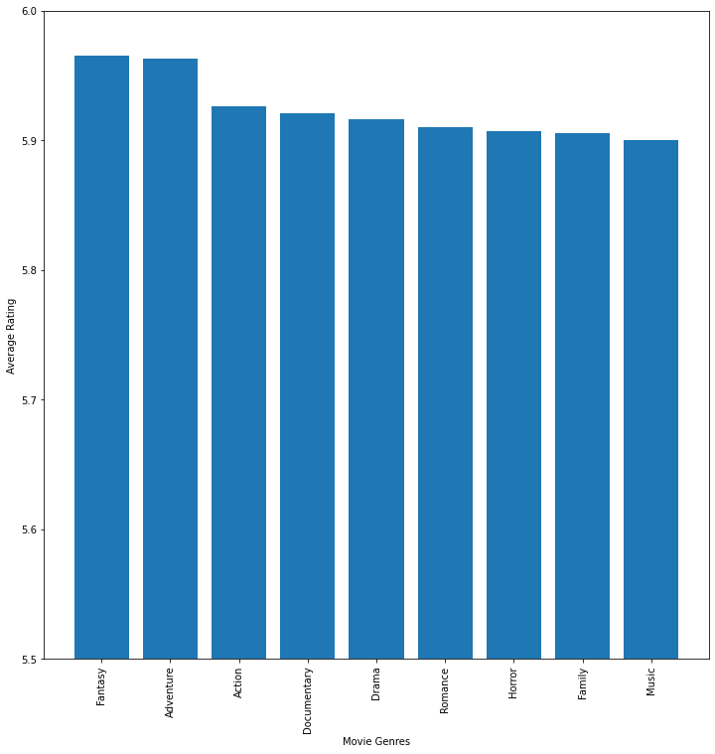
Average Rating by Genre
Fantasy & Adventure movies outperform
Opportunities to mix genres for unique movies
Favorite genre subject to change

Slide 3
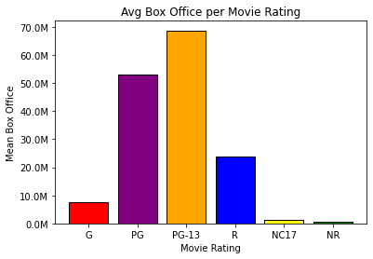
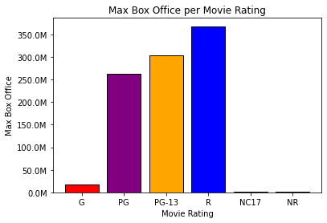
The Ratings Effect on Box-Office

Slide 4
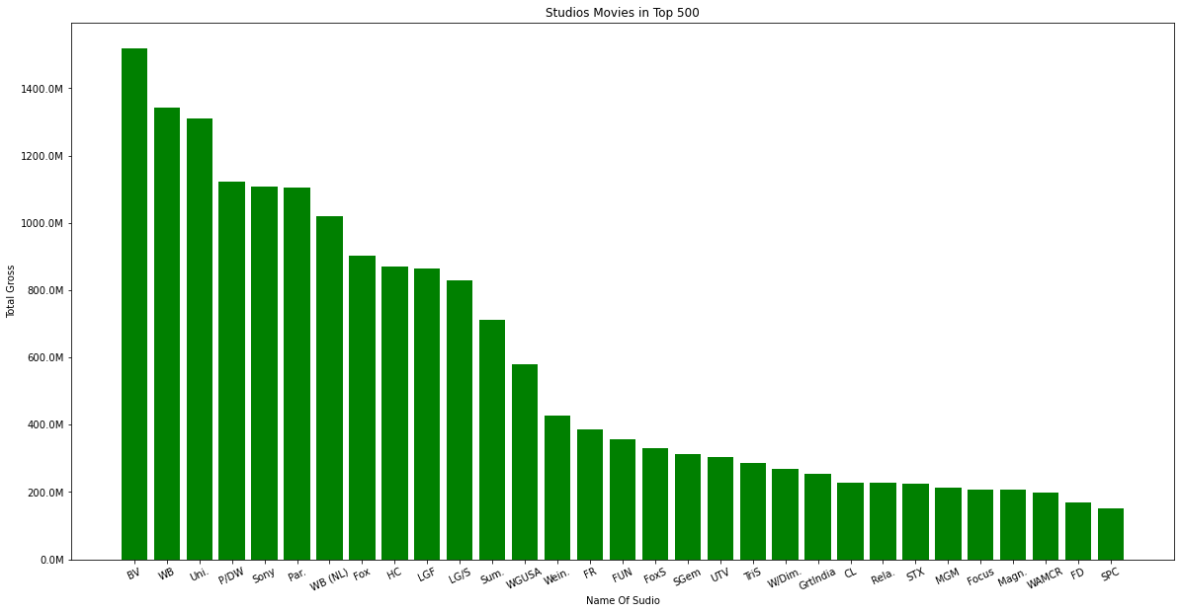
Successful Competitors/ Models to Follow

Slide 5
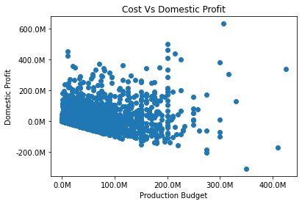
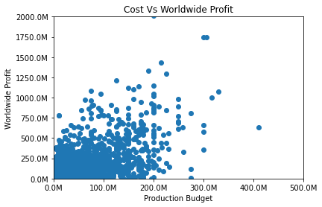
Budget vs. Profit
Spend money to make money (within limits)
Global films see more returns of financial investment than domestic films (Domestic)

Slide 6

In conclusion...
Genres matter
Target movie rating
Spend money to make money

Slide 7

Any questions?
Michael Schor
LinkedIn
Matthew Reinhart
LinkedIn
Daniel Arthur
LinkedIn
Adam Larsen
LinkedIn

